Slide 1
Minimizing Contamination by Employees Personal Hygiene Strategies
Department of Food Science
Penn State University

Slide 2
Key Strategies
Employee health and hygienic practices
Availability of handwashing, hand sanitizing, and toilet facilities
Education and training

Slide 3
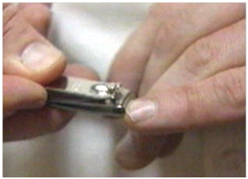
Good personal hygiene on the job starts at home
Encourage workers to: • Bathe or shower each day
• Keep hair clean and trimmed
• Keep fingernails short

Slide 4
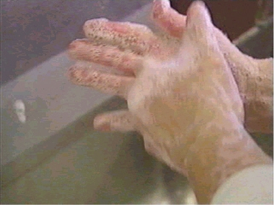
Regular and frequent handwashing
- the most critical factor for keeping food safe -
Research shows that fewer than 70% of adults in public restrooms take the time to wash their hands!
Training and regular reinforcement are essential
Notes:
Regular and frequent handwashing is the most important way you can keep food safe. Most people claim to wash their hands on a regular basis. But research studies show that fewer than 70% of adults in public restrooms take the time to wash their hands! Because your hands touch foods and food contact surfaces, washing your hands properly is vital to keeping foods safe.

Slide 5
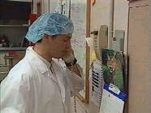
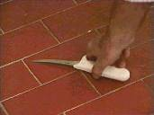
When hands should be washed
before starting work
after each absence from work stations such as breaks, lunch, and using the restroom
after handling items that are not clean and sanitary such as picking up something off the floor or retrieving items from storage areas
(continued…)

Slide 6
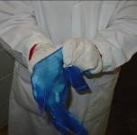
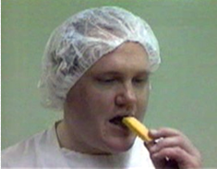
When hands should be washed (cont.)
after sneezing or coughing in your hands
after touching your face, hair, or soiled clothes
before putting on gloves
after eating, drinking, or using tobacco

Slide 7
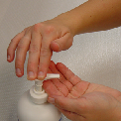
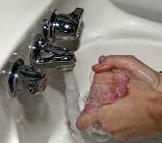
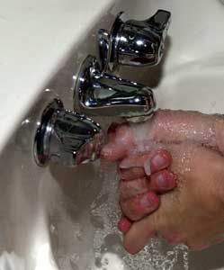
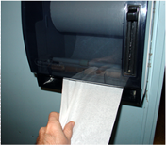
How to wash the hands
Remove any jewelry and wet your hands with clean, running, warm water.
Apply enough soap to build a good lather.
Scrub fingers, fingertips, areas between the fingers, and tops and bottom of hands for at least 10 to 15 seconds. Wrists and exposed parts of the arms too.
Rinse thoroughly to remove all traces of soap.
Then, dry hands using a disposable paper towel.

Slide 8
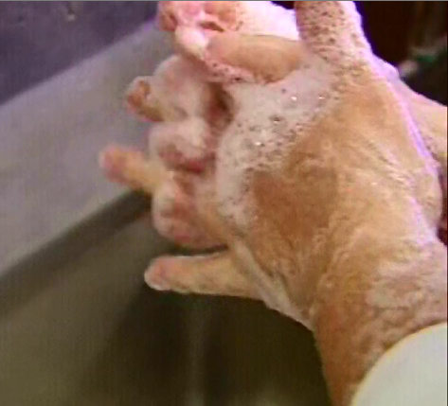
Effective scrubbing takes at least 10 to 15 seconds.
Remember to scrub your
fingers,
fingertips,
the areas between the fingers, and
the tops and bottom of your hands.
Don't forget your wrists and exposed parts of your arms.
Rinse all traces of soap using plenty of water.
Do you understand the correct way to wash your hands?
Notes:
[Timed with the movie]
Effective scrubbing takes at least 10 to 15 seconds.
Remember to scrub your fingers, fingertips, the areas between the fingers, and the tops and bottom of your hands.
Don't forget your wrists and exposed parts of your arms.
Rinse all traces of soap using plenty of water.

Slide 9
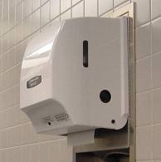
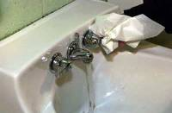
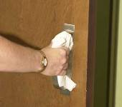
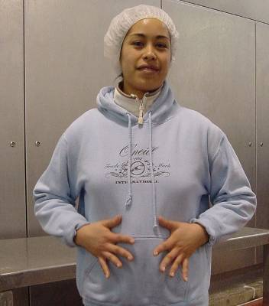
Prevent re-contamination after washing
Thoroughly dry hands with a disposable paper towel.
Wet hands pick up and transfer microorganisms much easier than dry hands.
Use the paper towel to turn off the water and to exit the room.
Throw the towel into a trash container.
Never dry hands on clothes!

Slide 10
Factors influencing handwashing effectiveness
Type of cleaner to loosen soils and bacteria
Type of sanitizer to kill microorganisms
Amount of friction to physically dislodge bacteria
Plenty of water to wash bacteria and soap residues down the drain
Water temperature – hot water is more effective than cool water

Slide 11
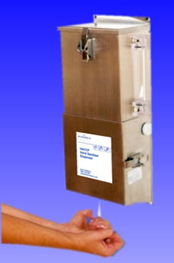
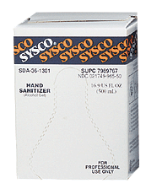
Hand Sanitizers
Formulated into soaps or as separate sprays, wipes, or dip stations
Pre-made solutions
Solutions made on-site
http://ww2.sysco.com/clean999/STAR/7990260.htm
Alcohol gel wipes

Slide 12
Types of Hand Sanitizers
1. Soaps and detergents
- Physically removes soils and bacteria
2. Chlorhexidine and Triclosan
- Residual activity
3. Alcohols
- Effective on cleaned hands, may irritate the skin
4. Iodophores
- Some residual activity but odor and staining may be a problem

